Slide 1
EE 4204 Computer Networks (Part 1)
Semester 2, 2021-22
TUTORIAL 2: PROBLEMS & SOLUTIONS
Lecturer: Assoc. Prof. Mohan Gurusamy
EE4204 (Part 1) Tut 2
G.Mohan / NUS

Slide 2
Problem 1
Problem:
Suppose that a certain communication protocol involves a per-packet overhead of 100 bytes for headers and framing. It is required to send 1 million bytes of DATA using this protocol. It is given that one data byte is corrupted and the entire packet containing it is thus lost necessitating retransmission of the lost packet. Give the total number of (header)overhead+retransmitted bytes for packet data sizes of 5000, 20000, and 25000 bytes. Determine the optimal packet data size.
EE4204 (Part 1) Tut 2
G.Mohan / NUS

Slide 3
Problem 1 (Contd.)
P_{N}
Solution
Let X be the packet data size, O be the (header)overhead+ retransmitted bytes, and N be the number of packets.
Since there are 1 million data bytes, N is given by 10⁶/X. It is given that the overhead is 100 bytes per packet. The size of retransmitted packet (which was lost) is X+100.
Therefore, O = N×100 + X+ 100
X=5000 ⇒ N = 200; and O = 25100 bytes
X=20000 ⇒ N = 50; and O = 25100 bytes
X=25000 ⇒ N = 40; and O = 29100 bytes
The optimum value is obtained when dO/dX = 0.
  O = 10⁶/X×100+X+100 = 10⁸/X+X+100
  dO/dX = -10⁸/X² + 1 = 0 ⇒ X = 10000
  When X =10000 the number of overhead+retransmitted bytes is minimum as d²O/dX² > 0
P₁
100
X
100
X
EE4204 (Part 1) Tut 2
G.Mohan / NUS

Slide 4
Problem 2
Small packets are preferred for realtime voice-over-IP applications. But, with a small packet size, a large fraction of link bandwidth is consumed by overhead bytes. To this end, suppose that the packet consists of L bytes and 5 bytes of header.
  Consider sending a digitally encoded voice source directly. Suppose the source is encoded at a constant rate of 128 kbps. Assume each packet is entirely filled before the source sends the packet into the network. The time required to fill a packet is the packetization delay. In terms of L, determine the packetization delay in milliseconds.
  Packetization delays greater than 20 msec can cause a noticeable and unpleasant echo. Determine the packetization delay for L = 1,500 bytes (roughly corresponding to a maximum-sized Ethernet frame) and for L = 48 (corresponding to an ATM packet or cell).
  Calculate the store-and-forward delay at a single switch for a link rate of R = 622 Mbps for L = 1,500 bytes, and for L = 48 bytes.
  Comment on the advantages of using a small packet size.
EE4204 (Part 1) Tut 2
G.Mohan / NUS

Slide 5
Problem 2 - Solution
2a) Packetization delay T_{pkt}= (L×8)/128=L/16 msec.
2b) L =1500 bytes. T_{pkt} = 1500/16 = 93.75 msec.
L= 48 bytes. T_{pkt} = 48/16 = 3 msec.
2c) size =1505 bytes. T_{t} = 1505×8/622 = 19.36 µs
size =53 bytes. T_{t} = 53×8/622 = 0.68 µs
2d) store-and-forward delay is very small (in µs) for both L = 1500 and L = 48 bytes. But, packetization delay for L =1500 is too high for real time voice application whereas small packets are good for such real time voice-over-IP applications.
EE4204 (Part 1) Tut 2
G.Mohan / NUS

Slide 6
Problem 3
Problem:
  What signal-to-noise ratio is needed to put a T1 carrier on a 50 KHz line?
Solution:
  Data rate of T1 carrier is 1.544 Mbps, i.e. C = 1.544 Mbps
  Bandwidth B = 50 KHz.
  Using C = B log₂(1+S/N), we get C/B = 30.88.
  S/N = 2^{30.88}-1 = about 93 dB
EE4204 (Part 1) Tut 2
G.Mohan / NUS

Slide 7
Problem 4
Problem:
  Assuming a framing protocol that uses bit stuffing, show the bit sequence transmitted over the link when the frame contains the following bit sequence (excluding flag bits):
  111111111100111111011111101
Solution:
  The transmitted bit sequence is given below. The stuffed bits are in bold and underlined.
  1111101111100011111010111110101
EE4204 (Part 1) Tut 2
G.Mohan / NUS

Slide 8
Problem 5
Problem:
  Assuming a framing protocol that uses byte stuffing, (i) Show the original data bytes extracted by the receiver upon receiving the following byte sequence (excluding flag bytes). (ii) What is the fraction of bandwidth wasted due to stuffing?
  2B 7D 5D 7D 5D 5D 5E 7D 5E 0E 7D 5E
Solution:
  The original data bytes extracted are:
    2B 7D 7D 5D 5E 7E 0E 7E
  Out of 12 bytes sent, 4 are overhead bytes due to stuffing. So, fraction of bandwidth wasted = 4/12 = 1/3
EE4204 (Part 1) Tut 2
G.Mohan / NUS

Slide 9
Problem 6
Problem:
  A receiver receives a bit stream 11101010 including the CRC bits. Suppose that the divisor polynomial used is x²+1, explain if the receiver detects any error.
Solution:
  Dividing 11101010 by 101 using modulo-2 arithmetic gives a non-zero remainder (01).
  Therefore, the receiver detects the error.
  Carry out the division to obtain the remainder.
EE4204 (Part 1) Tut 2
G.Mohan / NUS

Slide 10
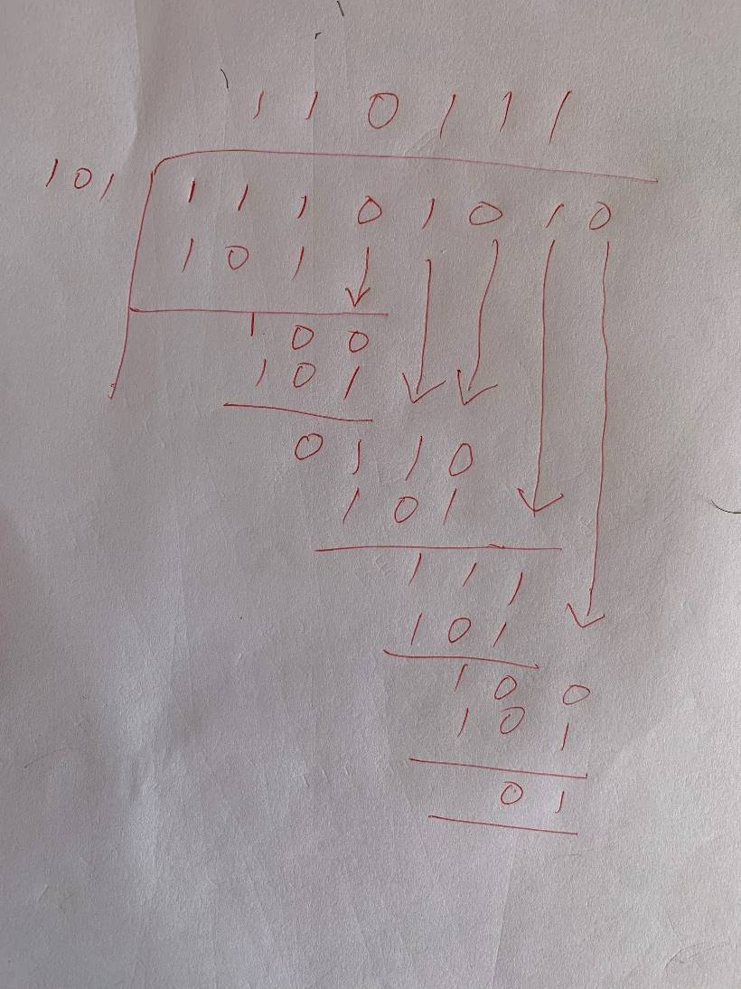
Problem 6 CRC calculation
EE4204 (Part 1) Tut 2
G.Mohan / NUS

Slide 11
Problem 7
Using the properties of CRC, verify if the generator (divisor) polynomial 1001 can detect (i) any single bit errors and (ii) any odd number of bit errors
Solution
  (i) the divisor polynomial has both x⁰ term and x^{k} term. Hence it can detect any single bit errors
  (ii) the divisor polynomial has factor x+1. Hence it can detect any odd number of bit errors. (how? the working is left to the students)
EE4204 (Part 1) Tut 2
G.Mohan / NUS

